Slide 1
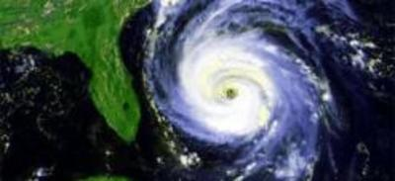
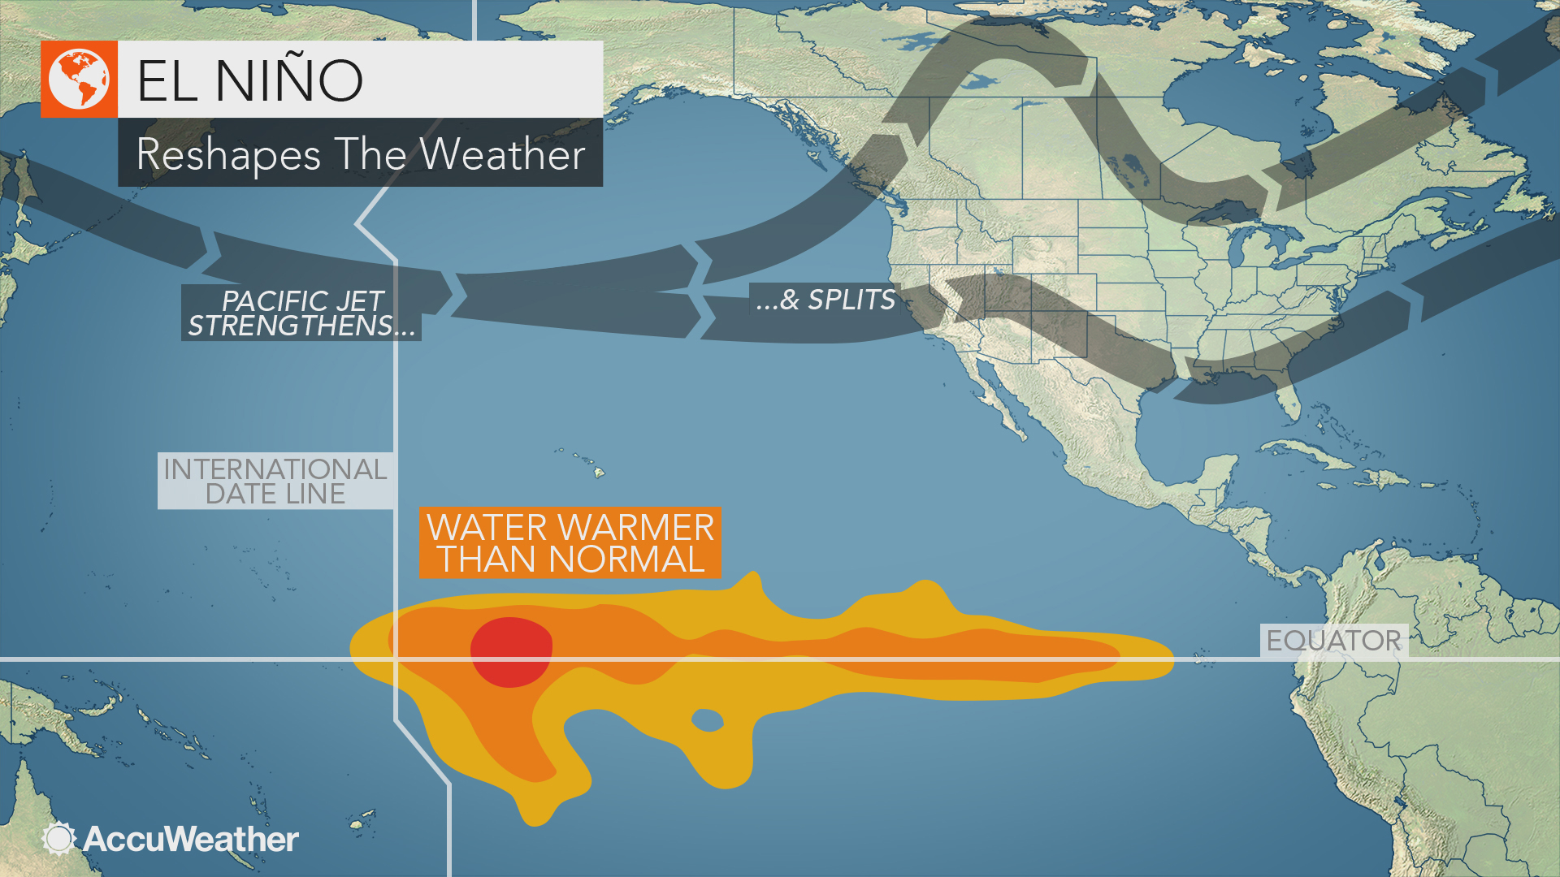
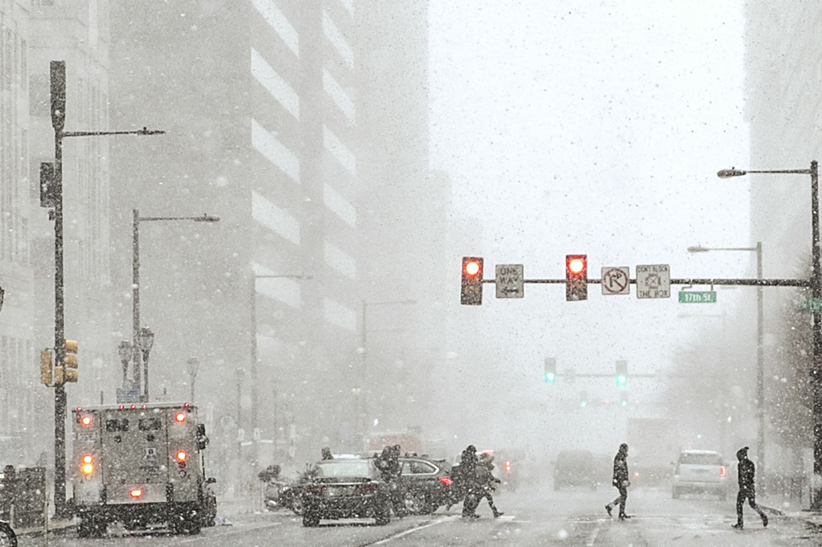
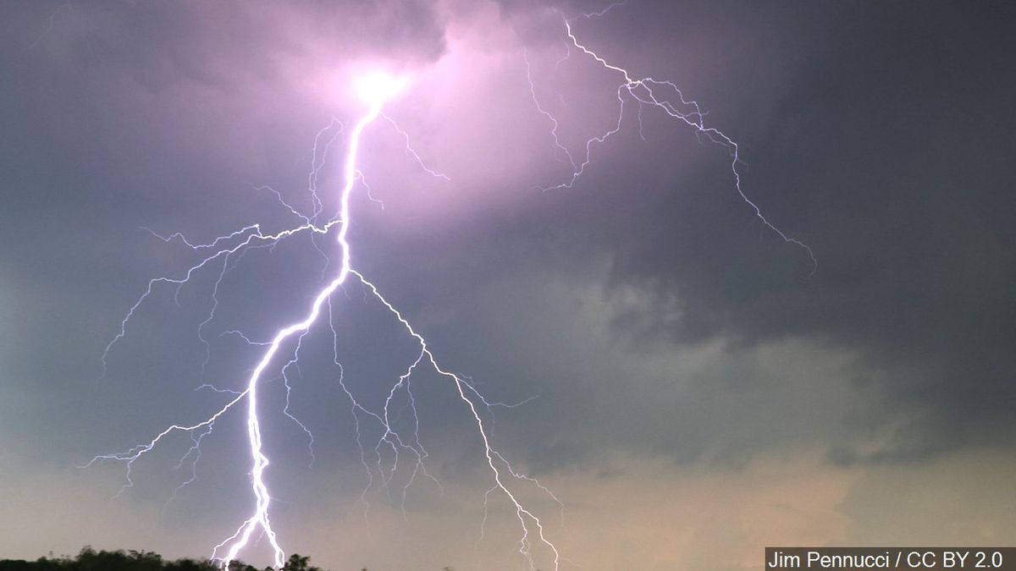
Tropical Meteorology Vs. Infrastructure
http://paocweb.mit.edu/images/uploads/medium/hurricane_fran_nasa.jpg
https://cms.accuweather.com/wp-content/uploads/2018/07/el-nino-reshapes-the-weather.jpg?w=632
Final Capstone Project for INT 250
https://gray-kalb-prod.cdn.arcpublishing.com/resizer/uTEkgflaTJNJ3Ukx3Mx65-NmpWU=/1200x675/smart/cloudfront-us-east-1.images.arcpublishing.com/gray/7TWKFJFQ75MYLP56JR36D4ZO2U.jpg
https://www.inquirer.com/resizer/_cQen3NUEyfbkoJ1lPUrJ6uKeI8=/1400x0/center/middle/arc-anglerfish-arc2-prod-pmn.s3.amazonaws.com/public/RJGEPC52GBB5FOQU2LEJEK42G4.jpg
May 11th, 2021 Justyce Countryman

Slide 2
What is Tropical Meteorology?
Researching, modeling, and observing the tropical atmosphere.
Crucial for analyzing hurricanes, winter storms, monsoons, dust storms, precipitation, severe thunderstorms, and El Niños.
Modern technological advancements have made it possible to create fewer inaccuracies.
Examples: A pair of satellites from NASA specifically used for tracking hurricanes, access to a variety of tropical meteorology fields, and frequent validity in scientific and mathematical data from weather balloons.

Slide 3
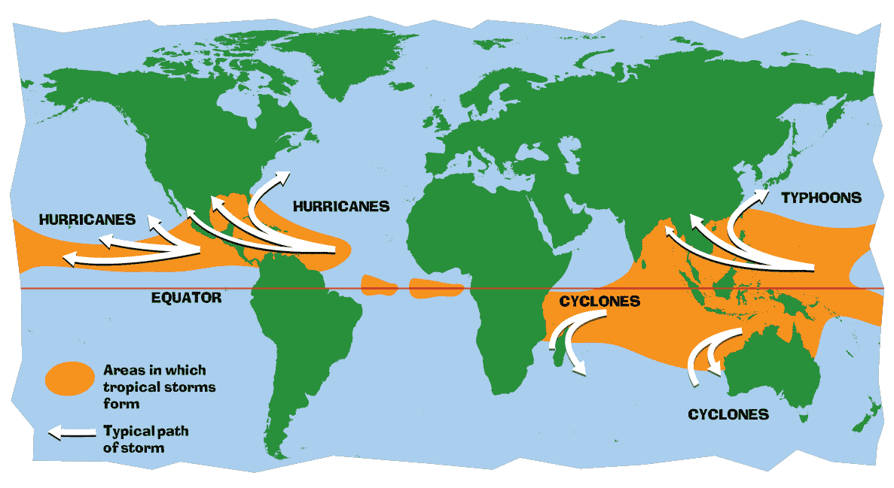
The Science Behind Hurricanes
What Makes them Extremely Dangerous Yet Interesting?
Formation often starts near warm waters.
Usually at or near the Equator for moist air.
The air combination goes aloft and far away from its regular surface.
Original surface is then filled with low atmospheric pressure.
https://gpm.nasa.gov/education/sites/default/files/article_images/cyclone_map_large.en.gif

Slide 4
Hurricanes (Continued)
What Happens with that Low Pressure?
Nearby areas with high pressure transfer their air to the location with lower pressure.
This combination of air on the surface results in another round of elevating air.
Produces high temperatures and moisture again.
This continuous process results in air spirals with additional neighboring air.
The upward air creates an arrangement of clouds and wind.
Strengthens by oceans and their high water temperatures, especially during evaporation.
https://gpm.nasa.gov/education/sites/default/files/article_images/cumulonimbus-lrg.en.jpg

Slide 5
Why Do Hurricanes Have A Center Eye?
The formation of a hurricane “eye” requires a lot of speed from the created wind and cloud structure.
Produces very little to no significant weather conditions.
Contains low atmospheric pressure initially.
High pressure from above the surface then travels down to the eye.
https://gpm.nasa.gov/education/sites/default/files/article_images/hurricane_diagram_large.en.jpg

Slide 6
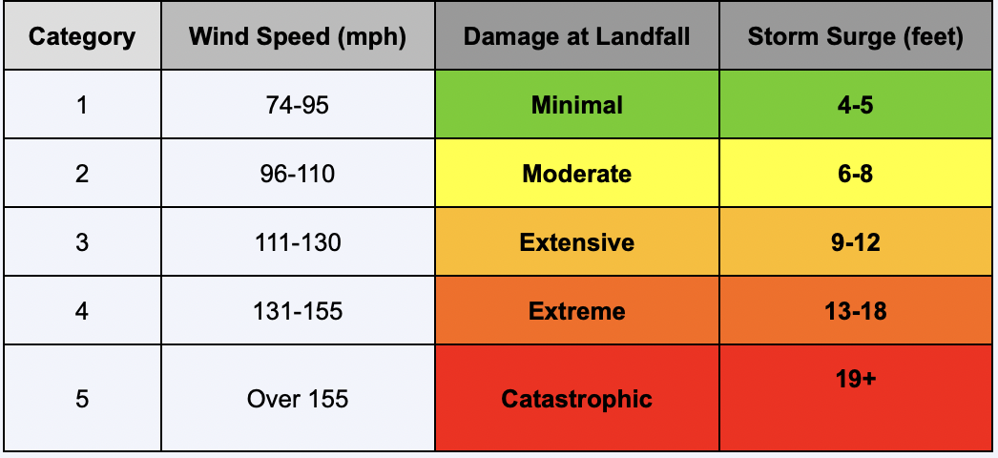
When A Hurricanes Makes Landfall…
…It Is Often Not As Bad As It Possibly Can Get
Hurricanes usually decrease in strength.
Occurs because of energy depletion once the system is far away from moist or warm ocean conditions.
They can still move hundreds of miles.
May produce inches or even feet of precipitation and 74+ mph winds.
Environmental features and infrastructure could be damaged or destroyed.

Slide 7
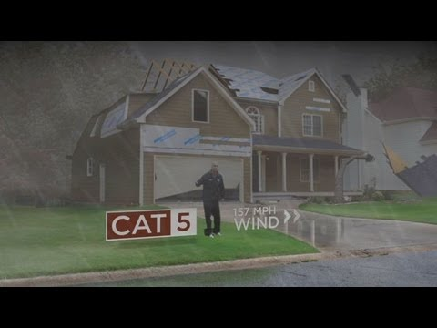
Question: Why do you Think There is No Such Thing as a Category 6+ Hurricane?

Slide 8
An Infrastructure Perspective
The damages from hurricanes are more critical and widespread than other weather phenomena.
“Electric distribution lines” are impacted by extreme winds or heavy rain.
Decreasing the vulnerability of the lines is a possible precautionary action.
Placing lines below the ground are more efficient, yet costly.
Underground lines could still be at risk due to flooding or “storm surges” (“Hurricanes and Electricity Infrastructure Hardening,” Web).
Examples: More trims on trees that are near the electrical lines or poles, tougher materials to replace weak poles, like substituting “metal or concrete poles” for “wooden poles,” and “guy” wires to keep the line poles sturdy and straight (“Hurricanes and Electricity Infrastructure Hardening,” Web).

Slide 9
“Problems like these often reflect an inclination of governments to spend as little money as possible” (Flavelle et al., Web).
Shalini Vajjhala, Former Obama Administration Official

Slide 10
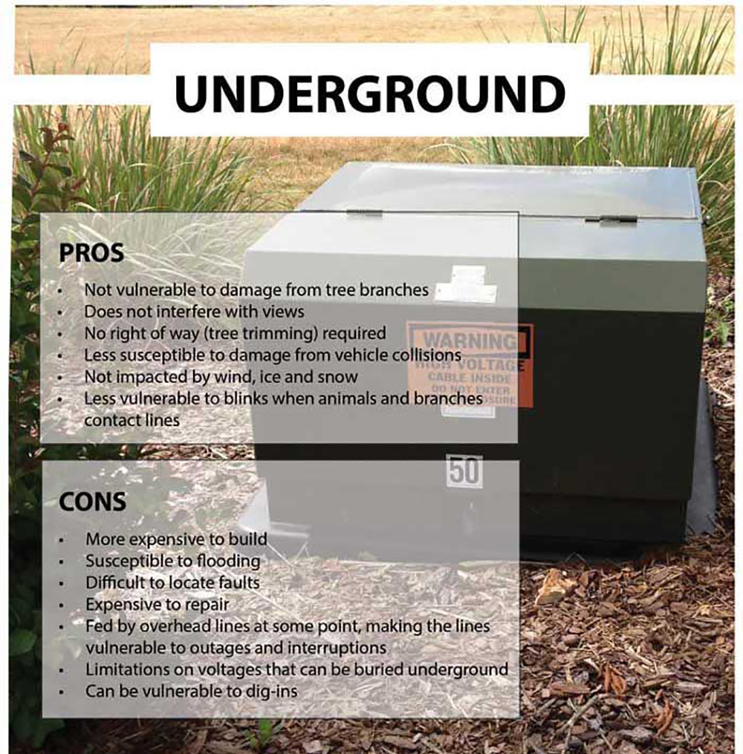
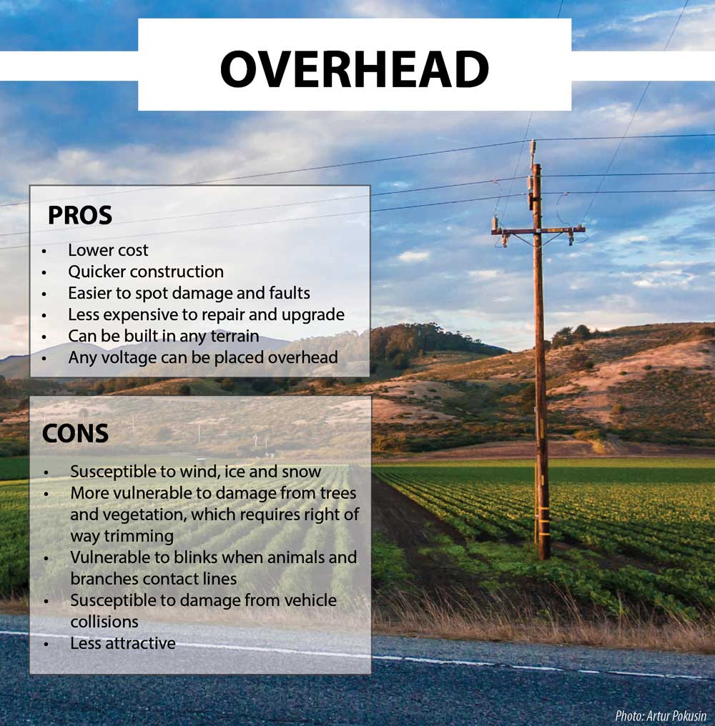
https://www.rock.coop/files/images/About%20Us/Underground.jpg
https://www.rock.coop/files/images/About%20Us/Overhead-graphic.jpg

Slide 11
Housing Infrastructure Vs. Weather
https://www.google.com/url?sa=i&url=https%3A%2F%2Fwww.pinterest.com%2Fpin%2F222506037815917953%2F&psig=AOvVaw3E9LlRR2kyximCLTepTeZV&ust=1620793896459000&source=images&cd=vfe&ved=0CAIQjRxqFwoTCOiz5_blwPACFQAAAAAdAAAAABAu
During Superstorm Sandy, over 650,000 homes were destroyed.
Over three hundred homes were lost in the district of Breezy Point in Queens, New York.
Building Architect Illya Azaroff constructed a house in 2019 that may handle storms more severe than Sandy.

Slide 12
How Is The House Hurricane Resistant?
https://www.insurancejournal.com/app/uploads/2019/05/storm-resistant-home-768x512.jpg
House is situated thirty-six inches above mean flood levels.
Foundation, floor, and walls are made of concrete.
Anticipated to handle extreme precipitation and wind speeds of up to three hundred miles per hour.
Contains “fiber cement board sidings” with flame resistance (Efstathiou and Gopal, Web).
Rigid, overlapping “polymer roof shingles” secured by bolts (Efstathiou and Gopal, Web).
Roof designed with robust “connectors” (Efstathiou and Gopal, Web).
https://dsx.weather.com//util/image/w/cba8ea2d-d9f8-4fb0-a676-8544315c2704.png?v=at&w=485&h=273&api=7db9fe61-7414-47b5-9871-e17d87b8b6a0

Slide 13
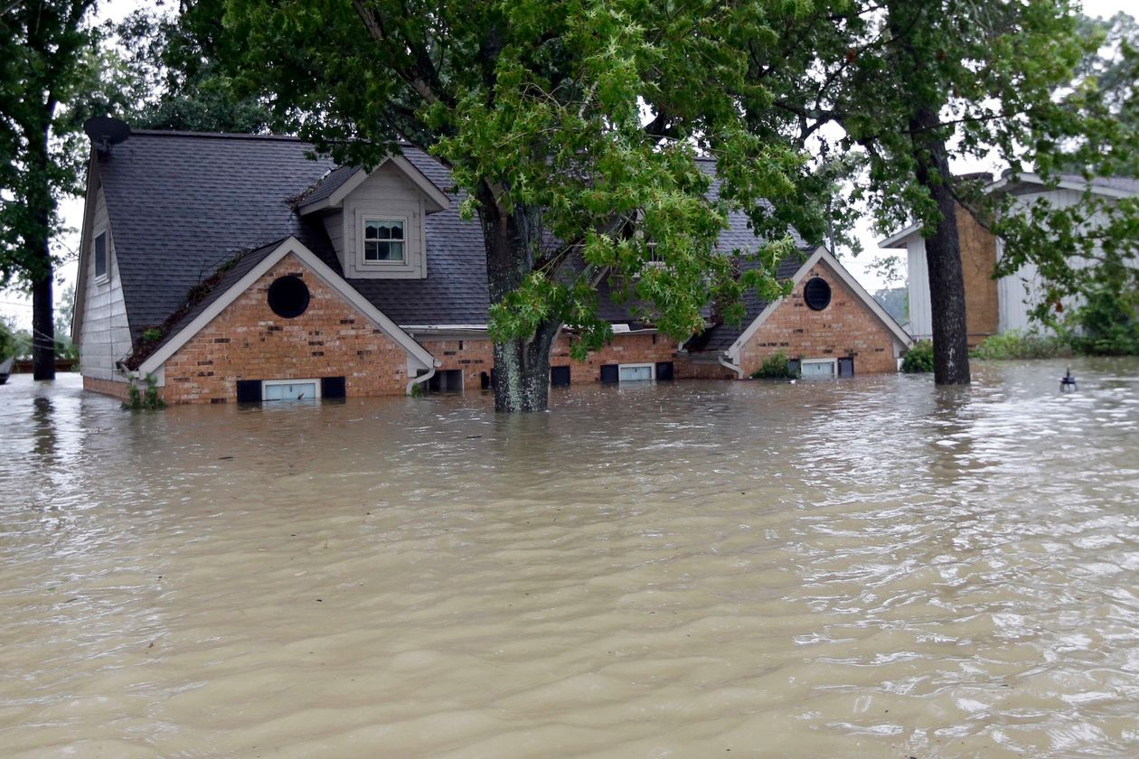
Primary Concern: Many Lower Class Family and African American Homes Have Very Little Protection From Natural Disasters
In 2017, Hurricane Harvey took over thirty thousand homes away in the southern United States.
Some individuals with little income were living in old or frail houses.
Others may have been in buildings that pose a high risk to indoor flooding.
African Americans also run the potential of the same problems, as well as living near industries that utilize hazardous materials.
Introduces exposure to chemicals or poisonous accidents.
All connect to the idea of severe weather, especially hurricanes.
https://images.wsj.net/im-137414?width=1260&size=1.5

Slide 14
Additional Concerns for African Americans and The U.S. Lower Class
No flood coverage
Less than twenty percent of homeowners from the eight most stricken counties due to Hurricane Harvey had insurance.
Uncontrollable decreases in “credit scores” (Krause and Reeves, Web)
Inability to find reasonably protected shelters after storms
Risk of homelessness
Long-term bankruptcy
Significant drops on property value, including expensive houses, could allow people with little money to find places to live.
Could result in local officials refusing to establish futuristic advancements in infrastructure.

Slide 15
Works Cited
http://ftp.comet.ucar.edu/memory-stick/tropical/textbook_2nd_edition/print_1.htm
https://gpm.nasa.gov/education/articles/how-do-hurricanes-form
https://www.youtube.com/watch?v=lqfExHpvLRY&t=1s
https://www.everycrsreport.com/reports/IN10781.html
https://www.nytimes.com/2021/02/20/climate/united-states-infrastructure-storms.html?action=click&module=Spotlight&pgtype=Homepage
https://www.worldvision.org/disaster-relief-news-stories/2012-hurricane-sandy-facts
https://www.insurancejournal.com/news/national/2019/05/13/526166.htm
https://www.brookings.edu/blog/social-mobility-memos/2017/09/18/hurricanes-hit-the-poor-the-hardest/

